Slide 1

Chapter 3: Pattern Discovery in Data Mining
Notes:
1

Slide 2
Mining Quality Phrases
Objective
Introduction to mining quality phrases or collocations
Methods for extracting meaningful phrases from textual data
Importance and applications of quality phrase mining in natural language processing
2

Slide 3
Mining Quality Phrases
Pattern Mining Applications: Mining Quality Phrases from Text Data
From Frequent Pattern Mining to Phrase Mining
Previous Phrase Mining Methods
ToPMine: Phrase Mining without Training Data
SegPhrase: Phrase Mining with Tiny Training Sets
3

Slide 4
Mining Quality Phrases
Why Phrase Mining?
Unigrams vs. phrases
Unigrams (single words) are often ambiguous
Example: “United”: United States? United Airline? United Parcel Service?
Phrase: A natural, meaningful, unambiguous semantic unit
Example: “United States” vs. “United Airline”
Mining semantically meaningful phrases
Transform text data from word granularity to phrase granularity
Enhance the power and efficiency at manipulating unstructured data
4

Slide 5
Mining Quality Phrases
Phrase Mining: Can We Reduce Annotation Cost?
Phrase mining: Originated from the NLP community—“Chunking”
Model it as a sequence labeling problem (B-NP, I-NP, O, …)
Need annotation and training
Annotate hundreds of documents as training data
Train a supervised model based on part-of-speech features
Recent trend:
Use distributional features based on web n-grams (Bergsma et al., 2010)
State-of-the-art performance: ~95% accuracy, ~88% phrase-level F-score
Limitations
High annotation cost, not scalable to a new language, a new domain/genre
May not fit domain-specific, dynamic, emerging applications
5

Slide 6
Mining Quality Phrases
Unsupervised Phrase Mining and Topic Modeling
Many studies of unsupervised phrase mining are linked with topic modeling T
Topic modeling
Represents documents by multiple topics in different proportions: Each topic is represented by a word distribution
Does not require any prior annotations or labeling of the documents
Statistical topic modeling algorithms The most common algorithm: LDA
Three strategies on phrase mining with topic modeling
Strategy 1: Generate bag-of-words → generate sequence of tokens
Strategy 2: Post bag-of-words model inference, visualize topics with n-grams
Strategy 3: Prior bag-of-words model inference, mine phrases and impose on the bag-of-words model
6

Slide 7
Mining Quality Phrases
Strategy 1: Simultaneously Inferring Phrases and Topics
Bigram Topic Model [Wallach’06]: Probabilistic generative model that conditions on previous word and topic when drawing next word T
opical N-Grams (TNG) [Wang, et al.’07] (a generalization of Bigram Topic Model): Probabilistic model that generates words in textual order - Create n-grams by concatenating successive bigrams
Phrase-Discovering LDA (PDLDA) [Lindsey, et al.’12]: Viewing each sentence as a time-series of words, PDLDA posits that the generative parameter (topic) changes periodically - Each word is drawn based on previous m words (context) and current phrase topic
Comments on this strategy: High model complexity: Tends to overfitting - High inference cost: Slow
7

Slide 8
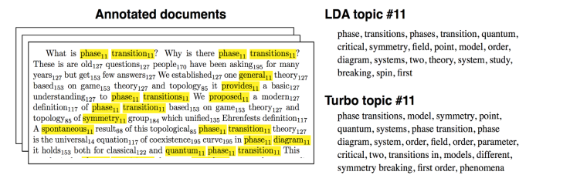
Mining Quality Phrases
Strategy 2: Post Topic-Modeling Phrase Construction (I): TurboTopics
TurboTopics [Blei & Lafferty’09] – Phrase construction as a post-processing step to Latent Dirichlet Allocation
Perform Latent Dirichlet Allocation on corpus to assign each token a topic label
Merge adjacent unigrams with the same topic label by a distribution-free permutation test on arbitrary-length back-off model
End recursive merging when all significant adjacent unigrams have been merged
8

Slide 9
Mining Quality Phrases
Post Topic-Modeling Phrase Construction (II): KERT
KERT [Danilevsky et al.’14] – Phrase construction as a post-processing step to LDA
Run bag-of-words model inference and assign topic label to each token
Perform frequent pattern mining to extract candidate phrases within each topic
Perform phrase ranking based on four different criteria
Popularity: e.g., “information retrieval” vs. “cross-language information retrieval”
Concordance “powerful tea” vs. “strong tea” “active learning” vs. “learning classification”
Informativeness: e.g., “this paper” (frequent but not discriminative, not informative)
Completeness: e.g., “vector machine” vs. “support vector machine
9

Slide 10
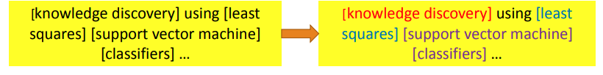
Mining Quality Phrases
Strategy 3: First Phrase Mining then Topic Modeling
Why first Phrase Mining then Topic Modeling?
With Strategy 2, tokens in the same phrase may be assigned to different topics
Ex. knowledge discovery using least squares support vector machine classifiers…
Knowledge discovery and support vector machine should have coherent topic labels
Solution: switch the order of phrase mining and topic model inference
10

Slide 11
Mining Quality Phrases
ToPMine: Phrase Mining before Topic Modeling
ToPMine [El-Kishky et al. VLDB’15]: Phrase mining, then phrase-based topic modeling
Phrase mining
Frequent contiguous pattern mining: Extract candidate phrases and their counts
Agglomerative merging of adjacent unigrams as guided by a significance score
Document segmentation to count phrase occurrence
Calculate rectified (i.e., true) phrase frequency
Phrase ranking (using the criteria proposed in KERT)
Popularity, concordance, informativeness, completeness
Phrase-based topic modeling
11

Slide 12
Mining Quality Phrases
Collocation Mining
Collocation: A sequence of words that occur more frequently than expected
Often “interesting”, relay information not portrayed by their constituent terms Ex. “made an exception”, “strong tea”
Many different measures used to extract collocations from a corpus [Dunning 93, Pederson 96] E.g., mutual information, t-test, z-test, chi-squared test, likelihood ratio
Many of these measures can be used to guide the agglomerative phrasesegmentation algorithm
12

Slide 13
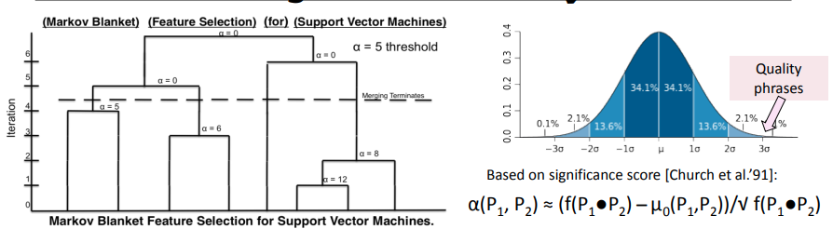
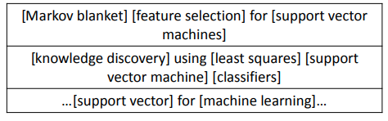
Mining Quality Phrases
Phrase Candidate Generation: Frequent Pattern Mining + Statistical Analysis
Note for the first title:
[feature selection] forms phrase but not [selection for] based on the significant scores computed
[support vector machine] does not contribute to the counts of [support], [vector], [support vector], [vector machine]
13

Slide 14
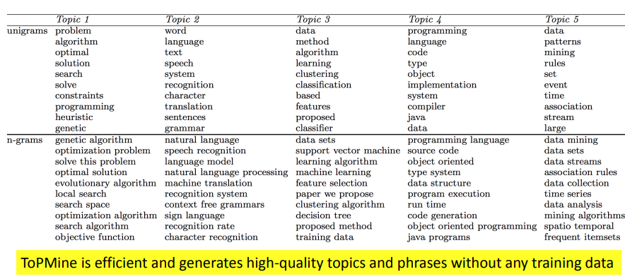
Mining Quality Phrases
ToPMine: Experiments on DBLP Abstracts
14

Slide 15
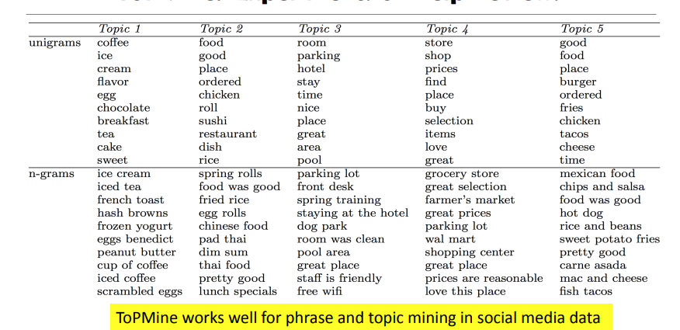
Mining Quality Phrases
ToPMine: Experiments on Yelp Reviews
15

Slide 16
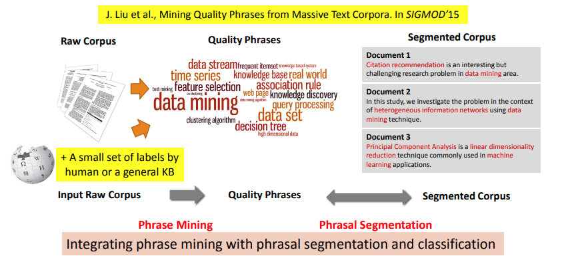
Mining Quality Phrases
SagPhrase: Phrase Mining with Tiny Training Sets
A small set of training data may enhance the quality of phrase mining
16

Slide 17
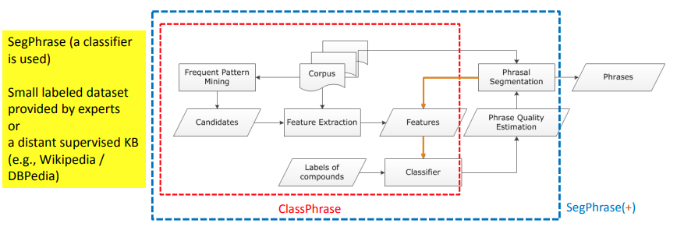
Mining Quality Phrases
SegPhrase+: The Overall Framework
ClassPhrase: Frequent pattern mining, feature extraction, classification
SegPhrase: Phrasal segmentation and phrase quality estimation
SegPhrase+: One more round to enhance mined phrase quality
17

Slide 18
Mining Quality Phrases
SegPhrase: Pattern Mining and Feature Extraction
Pattern Mining for Candidate Set
Build a candidate phrases set by frequent pattern mining
Mining frequent k-grams (k is typically small, e.g., 6 in the experiments)
Popularity measured by raw frequent words and phrases mined from the corpus
Feature Extraction: Concordance
Partition a phrase into two parts to check whether the co-occurrence is significantly higher than pure random
18

Slide 19
Mining Quality Phrases
SegPhrase: Pattern Mining and Feature Extraction
Feature Extraction: Informativeness
Quality phrases typically start and end with a non-stopword “machine learning is” vs. “machine learning”
Use average IDF over words in the phrase to measure the semantics
Usually, the probabilities of a quality phrase in quotes, brackets, or connected by hyphen should be higher (punctuations information)
e.g., “state-of-the-art”
19

Slide 20
Mining Quality Phrases
SegPhrase: Classification Using Tiny Training Sets
Use tiny training sets (300 labels for 1GB corpus; can also use phrases extracted from KBs)
Label: indicating whether a phrase is a high quality one
E.g., “support vector machine”: 1; “the experiment shows”: 0
Classification: Construct models to distinguish quality phrases from poor ones
Use Random Forest algorithm to bootstrap different datasets with limited labels
Phrasal segmentation can tell which phrase is more appropriate
Ex: “A standard [feature vector] [machine learning] setup is used to describe ......”
Partition a sequence of words by maximizing the likelihood
Consider length penalty and filter out phrases with low rectified frequency
20

Slide 21

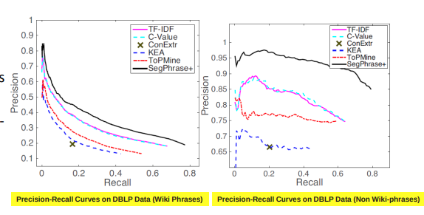
Mining Quality Phrases
Performance: Precision Recall Curves on DBLP
Datasets:
Evaluation
Wiki Phrases (based on internal links, ~7K high quality phrases)
Sampled 500*7 Wikiuncovered phrases: Results evaluated by 3 reviewers
Compared with other phrasemining methods
TF-IDF, C-Value, ConExtr, KEA, and ToPMine
Also, Segphrase+ is efficient, linearly scalable
21

Slide 22
Summary
Quality Phrase Mining
Identifying meaningful phrases.
Techniques for extraction.
Enhances language analysis tasks.
22

